Slide 1
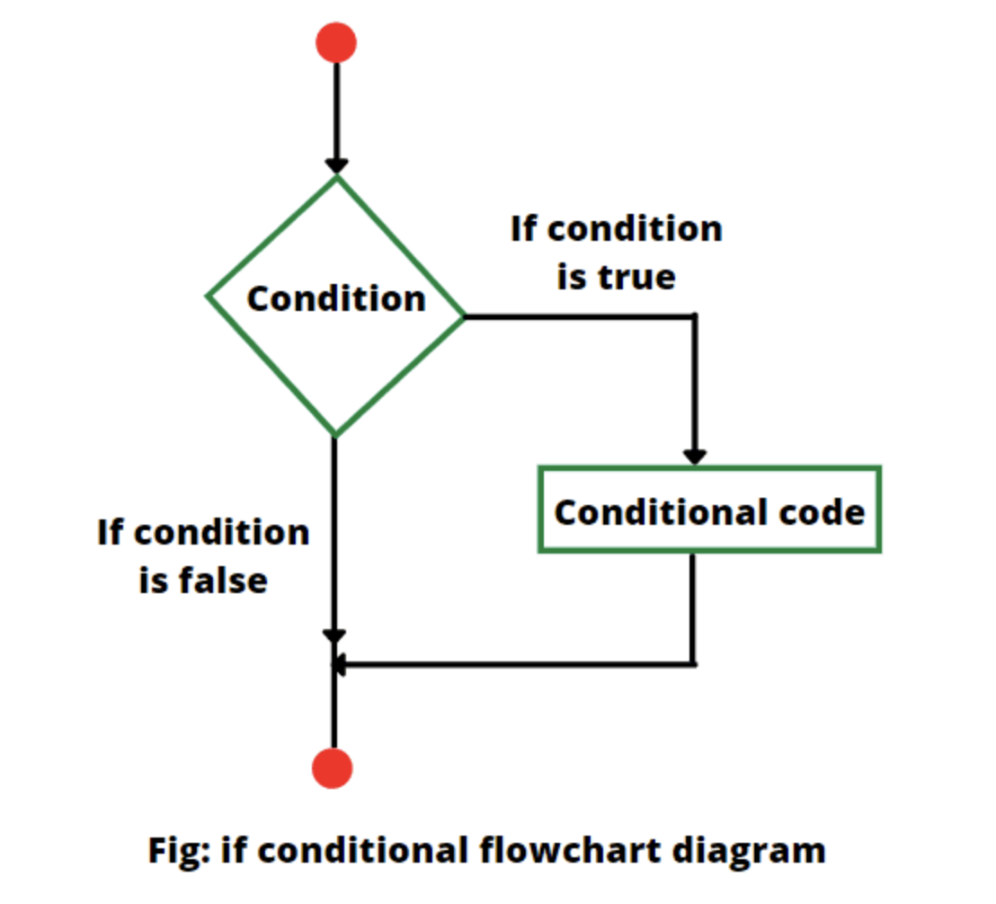
SESSION 4 — Conditional Statements
Shubham Rawat

Slide 2
Session Objective
By the end of this session, students will:
Write decision-based programs
Use if, if-else, and nested if statements
Implement else-if ladder
Use switch-case effectively
Understand fall-through concept
Learn Advanced switch (Java 14+)

Slide 3
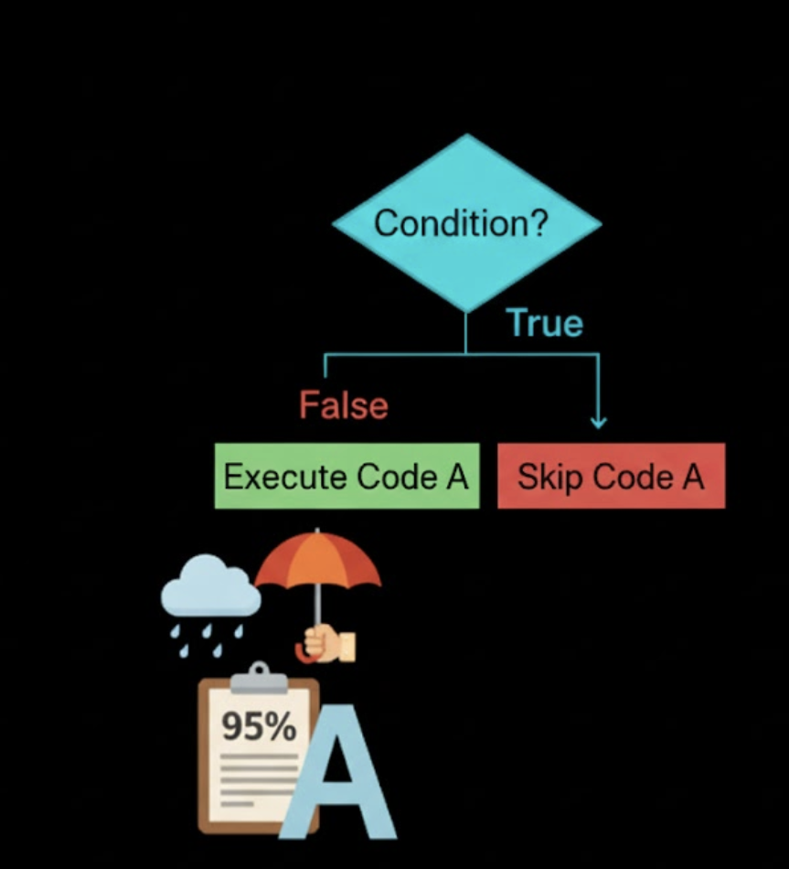
What are Conditional Statements?
Used to make decisions in a program
Control the flow of execution
Execute code based on conditions
Conditions return true or false
Real-life example:
If it rains → take umbrella
If marks > 90 → grade A

Slide 4
if Statement
Executes block only if condition is true.
if(condition) {
// code
}
Example:
int age = 18;
if(age >= 18)
System.out.println("Eligible to vote");

Slide 5
if-else Statement
Executes one block if true, another if false.
Syntax:
if(condition) {
// true block
} else {
// false block
}
Example:
int number = 5;
if(number % 2 == 0)
System.out.println("Even");
else
System.out.println("Odd");

Slide 6
ELSE-IF Ladder
Used when multiple conditions are checked.
Syntax:
if(condition1) {
}
else if(condition2) {
}
else {
}
Example (Grading System):
int marks = 85;
if(marks >= 90)
System.out.println("A");
else if(marks >= 80)
System.out.println("B");
else
System.out.println("C");
How else-if Works
Conditions checked from top to bottom
First true condition executes
Remaining conditions are skipped
If none true → else block executes
Important: Order matters!

Slide 7
Nested if Statement
An if inside another if.
int age = 20;
boolean hasID = true;
if(age >= 18) {
if(hasID) {
System.out.println("Entry allowed");
}
}
Used in authentication & validation systems.

Slide 8
switch-case Statement
Used when checking a single variable against multiple values.
Syntax:
switch(expression) {
case value1:
break;
case value2:
break;
default:
}
int day = 2;
switch(day) {
case 1:
System.out.println("Monday");
break;
case 2:
System.out.println("Tuesday");
break;
default:
System.out.println("Invalid");
}

Slide 9
Fall-Through Concept
If break is missing:
Execution continues to next case
Multiple cases execute
int x = 1;
switch(x) {
case 1:
System.out.println("One");
case 2:
System.out.println("Two");
}
Output: One Two
Because break is missing.

Slide 10
Advanced Switch (Java 14+)
New syntax using arrow (->).
int day = 3;
switch(day) {
case 1 -> System.out.println("Monday");
case 2 -> System.out.println("Tuesday");
default -> System.out.println("Other day");
}
Benefits:
Cleaner syntax
No fall-through
No break required

Slide 11
Real-Life Applications
Conditional statements are used in:
Grading systems
Login authentication
ATM machines
Menu-driven applications
Decision-making systems

Slide 12
Hands On
Task 1: Grading System
Write a program:
Input marks
Print grade using else-if ladder
Task 2: Menu-Driven Program
Create a program:
Add
Subtract
Multiply
Exit
Use switch-case.
Task 3: Login Validation
Create a simple login:
Input username
Input password
Check using if conditions
Print “Login Successful” or “Invalid Credentials”

